Slide 1


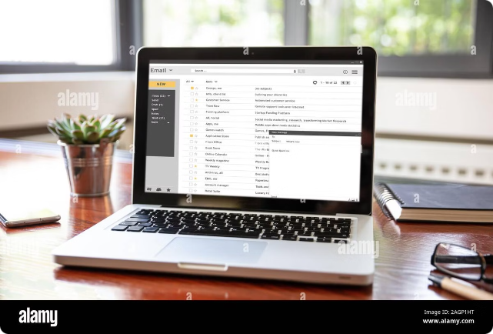
FUNCTIONAL
ROLE OF
EMAIL WRITING

Slide 2

Introduction
Email is a core communication tool for individuals and businesses. It is used for various purposes, including sharing information, collaborating on projects, and building relationships.

Slide 3


Functional role of Email Writing
1
Communication:
Documentation:
2
Email is a primary mode of communication for individuals and organizations. It allows people to share information quickly and efficiently, regardless of geographical barriers
Emails serve as a record of communication that can be referred to later. This is important for maintaining records of conversations, decisions, agreements, and exchanges of information.
3
Information Sharing
Coordination:
4
Emails can be used to distribute information to multiple recipients simultaneously, making it a powerful tool for sharing updates, reports, and news.
Email helps in coordinating tasks and projects by allowing team members to discuss details, set deadlines, and allocate responsibilities.

Slide 4

Functional role of Email Writing
5
Professional Networking
6
Marketing and Promotion::
Emails provide a platform for professional networking and relationship-building. They allow individuals to connect with colleagues, clients, and industry professionals.
Organizations use emails for marketing purposes, sending newsletters, promotional offers, and updates to customers and potential clients..
7
Customer Service
8
Formal Communication
Emails are often used for formal communication within and between organizations, such as sending official notices, invitations, or announcements.
Email is an essential tool for customer service, allowing businesses to respond to inquiries, address complaints, and provide support.

Slide 5
Question: How does email serve as a tool for documentation?
A) By recording conversations and decisions for future reference
B) By storing large video files
C) By providing live streaming capabilities
D) By allowing unlimited file storage

Slide 6
Question: How does email serve as a tool for documentation?
A) By recording conversations and decisions for future reference
B) By storing large video files
C) By providing live streaming capabilities
D) By allowing unlimited file storage
Answer: A) By recording conversations and decisions for future reference

Slide 7
Question: What is one of the primary functions of email in a professional setting?
A) Sending jokes to friends
B) Facilitating quick and efficient communication
C) Sharing personal photos
D) Watching movies online

Slide 8
Question: What is one of the primary functions of email in a professional setting?
A) Sending jokes to friends
B) Facilitating quick and efficient communication
C) Sharing personal photos
D) Watching movies online
Answer: B) Facilitating quick and efficient communication

Slide 9
Key Elements of a Well-Written Email
A well-written email includes a clear subject line, a concise and focused message, and a professional closing.
Subject Line
Body
Closing
A clear and concise subject line that accurately reflects the email's content.
A well-organized body with clear paragraphs, bullet points, or numbered lists when appropriate.
A professional closing that includes a call to action or a polite farewell.

Slide 10
Question: Why is it important to have a clear subject line in an email?
A) To make the email appear more interesting
B) To ensure the recipient knows the email’s purpose at a glance
C) To add creativity to the email
D) To avoid the email being marked as spam

Slide 11
Question: Why is it important to have a clear subject line in an email?
A) To make the email appear more interesting
B) To ensure the recipient knows the email’s purpose at a glance
C) To add creativity to the email
D) To avoid the email being marked as spam
Answer: B) To ensure the recipient knows the email’s purpose at a glance

Slide 12

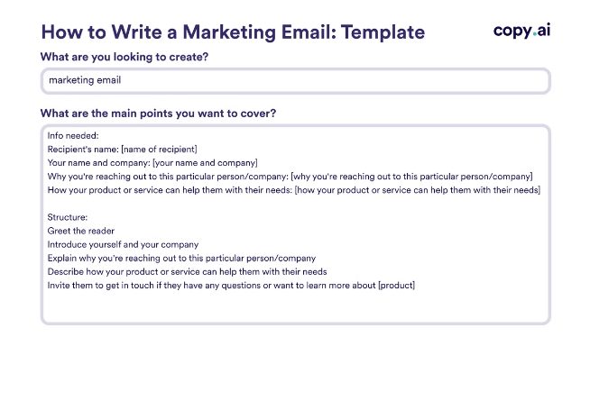
Formatting and Structure for Clarity
Proper formatting and structure enhance readability and make it easier for recipients to understand the message.
Paragraph Breaks
White Space
Use paragraph breaks to separate different ideas and improve readability.
Leave sufficient white space between lines and paragraphs to prevent the message from appearing cluttered.
Font Style
Font Size
Use a professional font style, such as Arial or Times New Roman, and maintain consistency throughout the email.
Choose a font size that is easy to read, typically between 10 and 12 points.

Slide 13


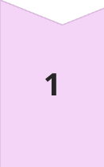
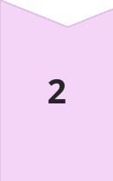
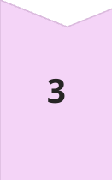
Tone and Language Considerations
The tone and language used in emails should be appropriate for the recipient and the purpose of the message.
Professional
Maintain a professional tone, using formal language and avoiding slang or informal expressions.
Respectful
Treat recipients with respect, using polite language and avoiding offensive or discriminatory remarks.
Clear and Concise
Use clear and concise language, avoiding jargon or technical terms that may not be understood by the recipient.

Slide 14
Question 1: Why is it important to consider the tone of an email?
A) To make the email sound dramatic
B) To ensure the message is received as intended and appropriate for the audience
C) To confuse the recipient
D) To make the email longer

Slide 15
Question 1: Why is it important to consider the tone of an email?
A) To make the email sound dramatic
B) To ensure the message is received as intended and appropriate for the audience
C) To confuse the recipient
D) To make the email longer
Answer: B) To ensure the message is received as intended and appropriate for the audience

Slide 16

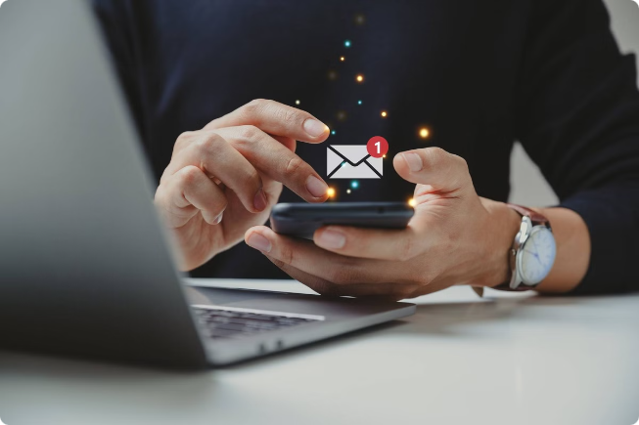
Strategies for Managing Email Overload
Managing email overload is crucial for staying organized and productive. Effective strategies include prioritizing emails, using folders to organize messages, and setting aside specific times for checking emails.
Prioritize
Use flags or labels to mark important emails and address them first.
Organize
Create folders for different categories of emails, such as work, personal, and subscriptions.
Schedule
Set aside specific times for checking and responding to emails to avoid constant distractions.

Slide 17
Situation 1: Job Application
Question: You are applying for a marketing position at a company you admire.
How would you craft an email to the hiring manager introducing yourself and highlighting your relevant experience?

Slide 18
Key Points: Emphasize your skills, mention specific experiences related to marketing, and express enthusiasm for the role.
Dear [Hiring Manager's Name],
I am writing to express my interest in the Marketing position at [Company Name] as advertised on your careers page. With a Bachelor’s degree
in Marketing and over three years of experience in digital marketing and content creation, I am excited about the opportunity to contribute to
your team.
In my previous role at [Previous Company], I successfully led a campaign that increased our online engagement by 30% within six months.
I am particularly impressed with [Company Name]’s innovative approach to marketing and am eager to bring my skills in social media strategy
and data analysis to your team.
Thank you for considering my application. I look forward to the possibility of discussing how I can contribute to your company’s success.
Warm regards,
[Your Full Name]
[Your Contact Information]

Slide 19

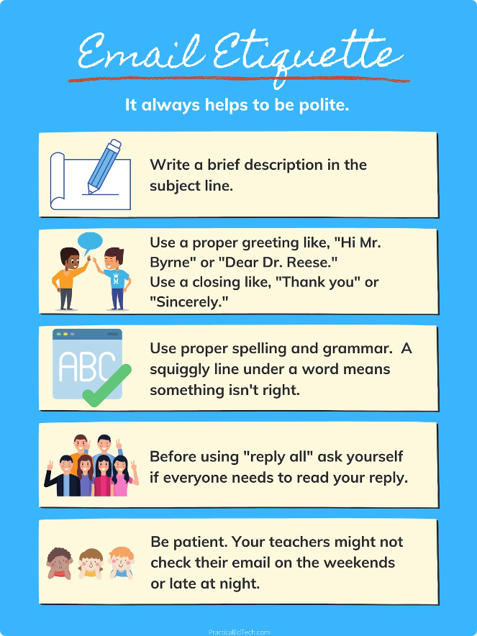




Best Practices for Email Etiquette
Following email etiquette ensures that messages are received and interpreted professionally.
Respond Promptly
Proofread Carefully
Respond to emails promptly, within a reasonable timeframe, especially if the message requires urgent attention.
Proofread emails for errors in grammar, spelling, and punctuation before sending.
Attach Files Properly
Avoid Forwarding Unnecessarily
Attach files only when necessary, ensuring that the file size is appropriate and the format is compatible with the recipient's system.
Avoid forwarding emails to multiple recipients unless absolutely necessary, and always obtain consent from the original sender before forwarding.

Slide 20
Question: What is the importance of email etiquette in professional communication?
A) It makes emails more colorful and entertaining.
B) It ensures clarity and respect, which can enhance professional relationships.
C) It allows for more casual interactions with colleagues.
D) It limits the need for formal language

Slide 21
Question: What is the importance of email etiquette in professional communication?
A) It makes emails more colorful and entertaining.
B) It ensures clarity and respect, which can enhance professional relationships.
C) It allows for more casual interactions with colleagues.
D) It limits the need for formal language
Answer: B) It ensures clarity and respect, which can enhance professional relationships.

Slide 22
Question 4: Which of the following best describes the role of email in professional networking?
A) It is used to send chain letters to colleagues.
B) It helps in building and maintaining professional relationships.
C) It is used solely for internal communication within a company.
D) It allows for anonymous communication with peers

Slide 23
Question 4: Which of the following best describes the role of email in professional networking?
A) It is used to send chain letters to colleagues.
B) It helps in building and maintaining professional relationships.
C) It is used solely for internal communication within a company.
D) It allows for anonymous communication with peers
Answer: B) It helps in building and maintaining professional relationships.

Slide 24
Key Takeaways
Email remains a vital communication tool in today's digital world. Mastering effective email writing skills can significantly enhance productivity, professionalism, and relationships.
Clarity
1
Ensure your emails are clear, concise, and easy to understand.
2
Professionalism
Maintain a professional tone and use appropriate language for all communications.
Organization
3
Structure your emails effectively, using formatting and white space for clarity.
4
Respect
Treat recipients with respect, addressing them appropriately and using polite language.
Timeliness
5
Respond to emails promptly and within a reasonable timeframe.

Slide 25
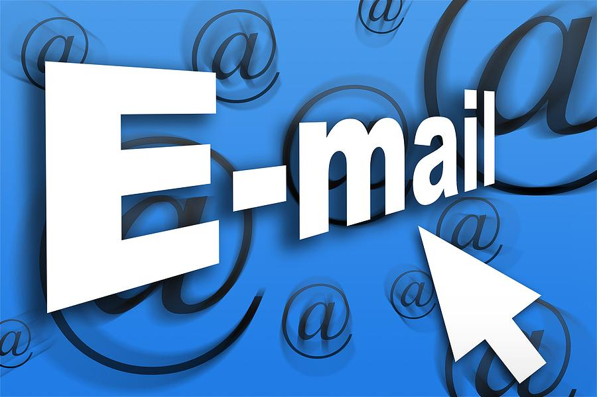
THANK
YOU

